Slide 1


Slide 2
Nginx & chill

Slide 3




Nginx & Chill
Presenter’s Names
Anshika Shrivastava
Anurag Negi
Sairanjan Subudhi
Dhruv Jain

Slide 4

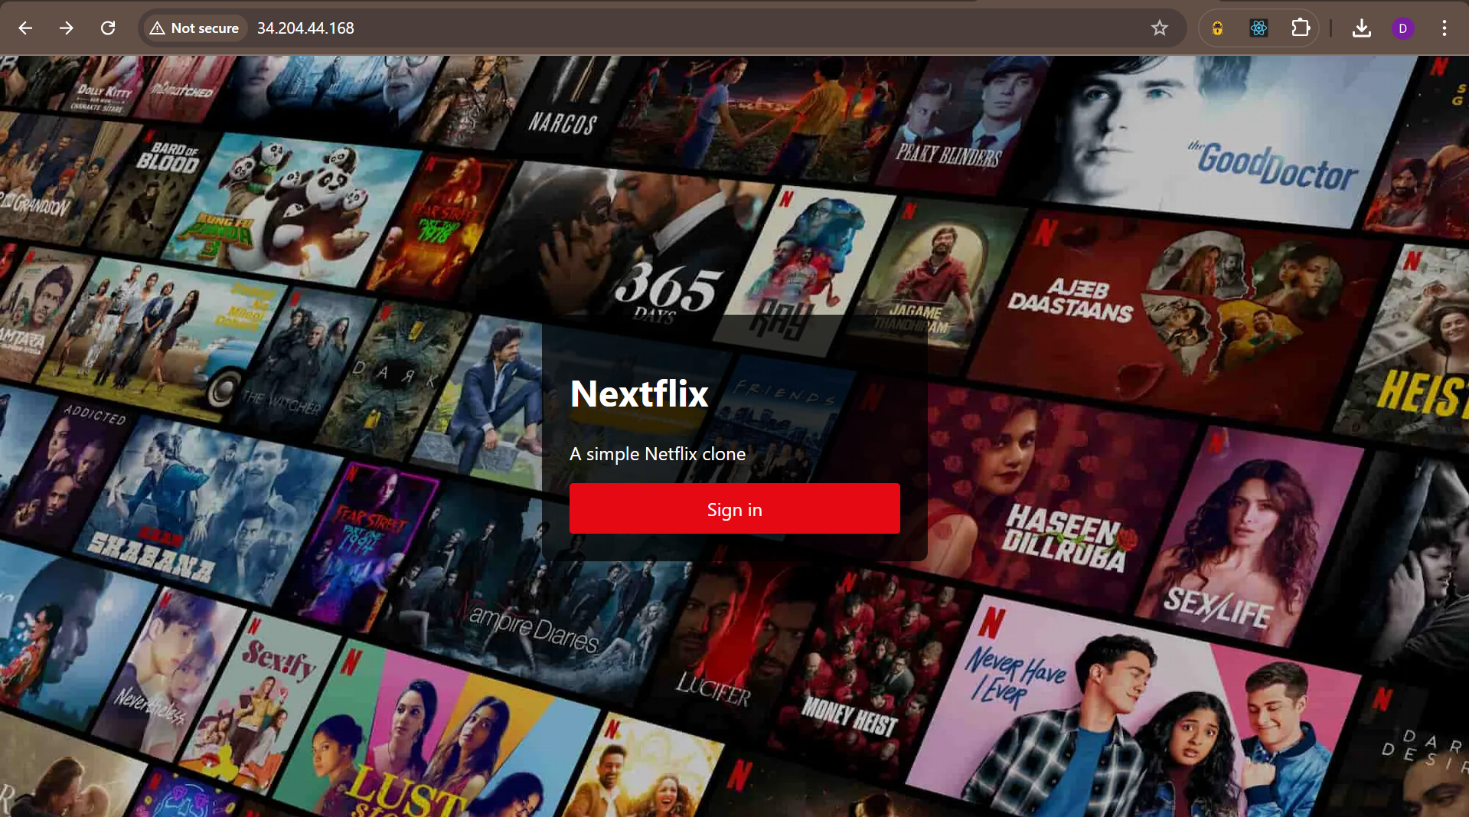
Nginx & Chill
4
INTRODUCTION
97% for you
16+
2022
The Netflix Movie Catalog project aims to replicate the core functionalities of Netflix by providing a movie catalog for users to browse through. It consists of a movie catalog and a frontend user interface for interaction. The objective is to deploy these microservices via Docker in a scalable and efficient manner using AWS EC2 instances.
Skip

Slide 5

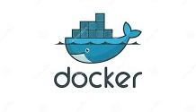


Nginx & Chill
4
Tech Stack
97% for you
16+
2022
The deployment includes the backend service (Python-based Netflix Movie Catalog), the frontend (NetflixFrontend clone), and Nginx as a reverse proxy for routing traffic. This demonstrates real-world DevOps practices by leveraging cloud infrastructure and containerization.
Skip

Slide 6
Deployment Architecture

Slide 7
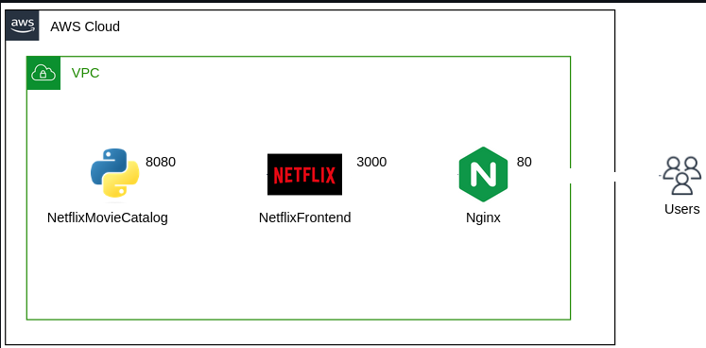

Slide 8
Procedure

Slide 9



Private Key
Port 22
Local Machine

Slide 10



Port 22

Slide 11


configurations
default.conf

Slide 12
thanks

